Slide 1
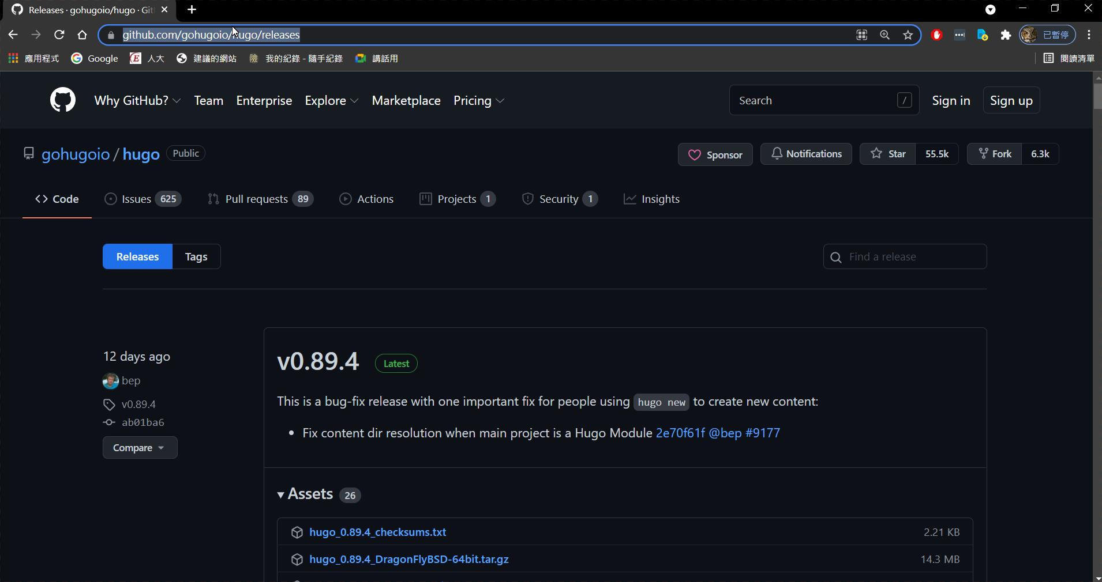
https://github.com/gohugoio/hugo/releases

Slide 2
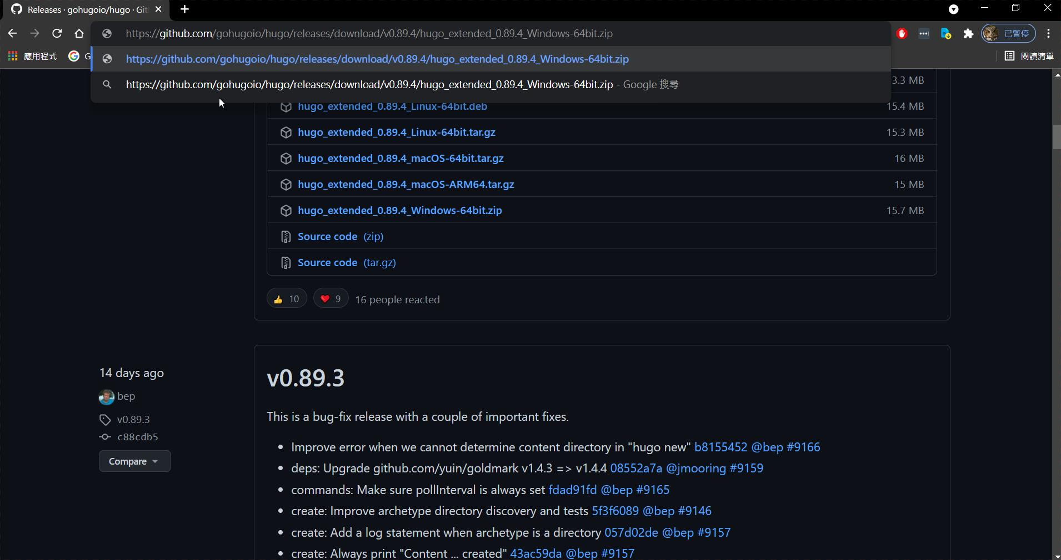
https://github.com/gohugoio/hugo/releases/download/v0.89.4/hugo_extended_0.89.4_Windows-64bit.zip

Slide 3
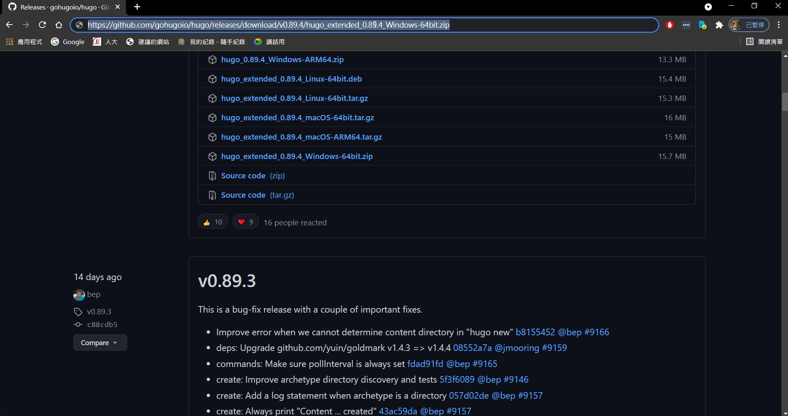
https://github.com/gohugoio/hugo/releases/download/v0.89.4/hugo_extended_0.89.4_Windows-64bit.zip

Slide 4
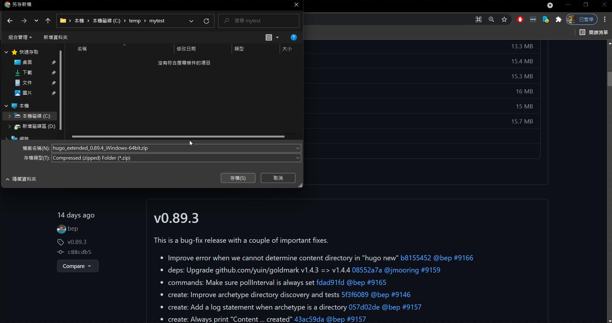
我放在c:/temp/mytest中

Slide 5
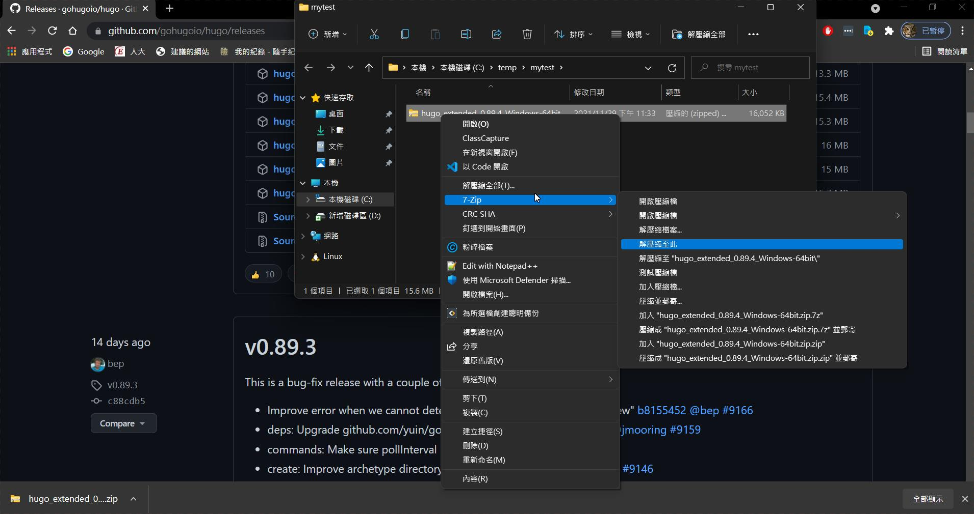
解壓縮

Slide 6
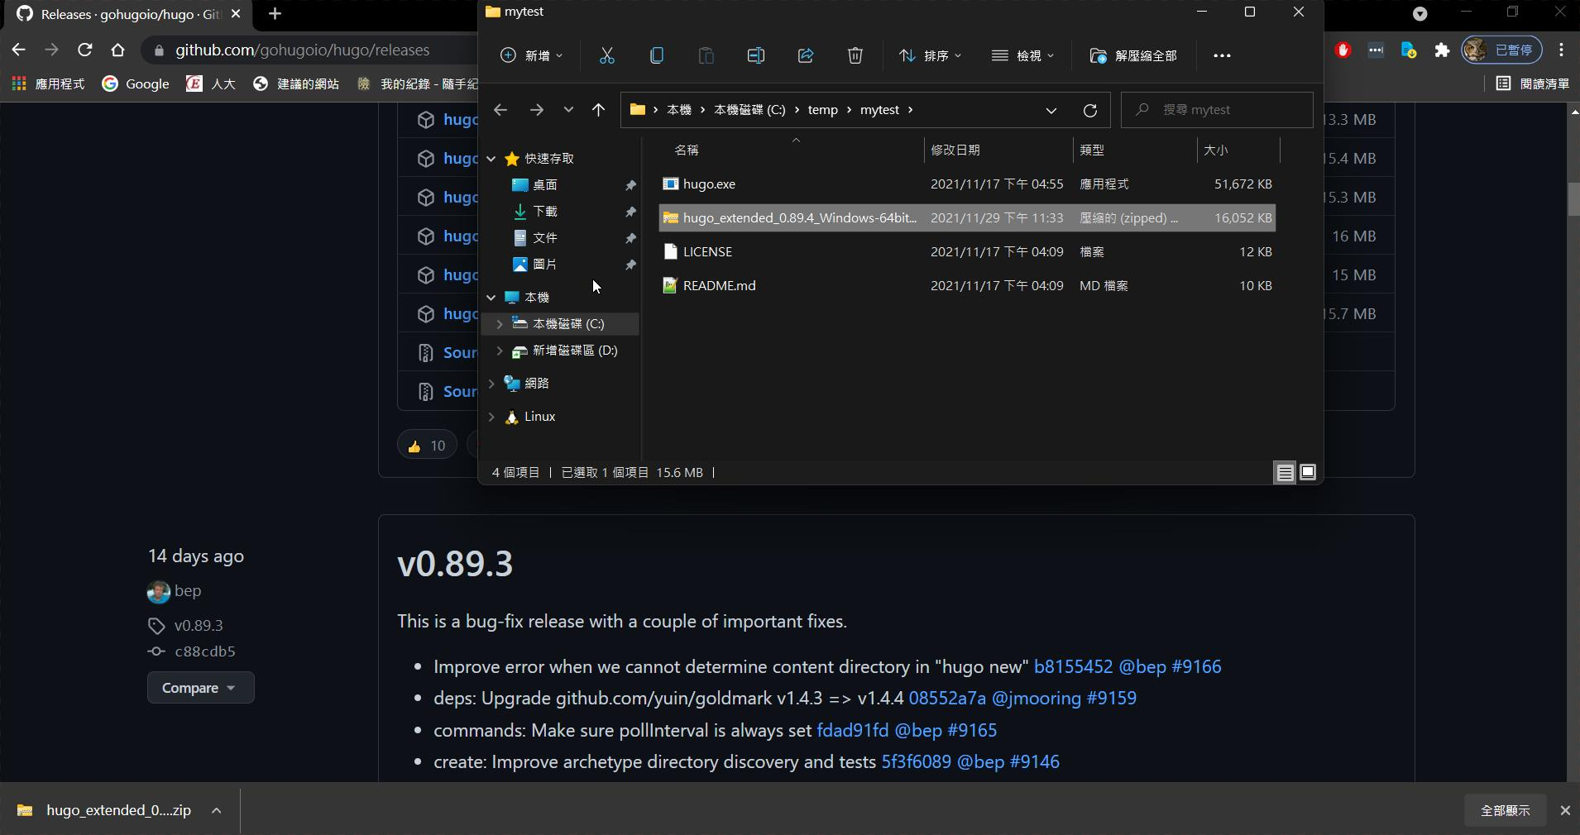
產生三個檔案

